Slide 1

Audio-Visual Emotion
Recognition System
Shoubra Faculty of Engineering

Slide 2

TEAM MEMBERS
MAHMOUD MOHAMED ABD ELWAHAB
AMR KAMAL
MARWA ADEL
MARIAM MAHER
MOHAMED RAMDAN
Supervised by
Dr:Eman Abdelghafer

Slide 3
PROJECT SCOPE
OVERVIEW PROJECT PHASSES
RELATED WORK
CONTENTS
PHASE ONE
ESTIMATED ANNOUNCE DATES
audio model
NEXT PHASES
video and fusion
REFERENCES
AAI | Pro X

Slide 4


PROBLEM STATEMENT
Emotion recognition is an important research field for Human-Computer Interaction. Emotion recognition has many applications for examples helping children with autism, helping people who are blind to read facial expressions, helping robots interact more intelligently with people and companies want to improve customers experience.
PROJECT SCOPE
Classify six emotions neutral, calm, happy, sad, angry and fearful from audio and video.

Slide 5



PHASSES PROJECT
audio phase
video phase
fusion phase

Slide 6
Related
work

Slide 7
audio
Related work

Slide 8
Paper | Year | Dataset | Feature Extraction | Model | Accuracy |  | Average accuracy | # Class
Emotion Recognition from Speech Signals Using Machine Learning and Deep Learning Techniques. [1] | 2021 | RAVDESS SAVEE | MFCC | random forest | RAVDESS | 61.81% | ---- | 8
 |  |  |  |  | SAVEE | 68.75% | ----
 |  |  |  | MLPNN | RAVDESS | 68.75% | 70.65%
 |  |  |  |  | SAVEE | 75% | ---
 |  |  |  | SVM | SAVEE | 70.83% | ---
 |  |  |  |  | RAVDESS | 70.13% | ----
 |  |  |  | CNN | RAVDESS | 70.83% best | ----
 |  |  |  |  | SAVEE | 61.46% | ----
 |  |  |  | KNN | RAVDESS | 61.11% | ----
 |  |  |  |  | SAVEE | 63.54% | ----

Slide 9
Paper | Year | Dataset | Feature Extraction | Model | Accuracy | Average accuracy | #class
Improved Speech Emotion Recognition using Transfer Learning and Spectrogram Augmentation [2] | 2021 | IEMOCAP | Mel spectrogram | ResNet34 | 3 Experiment on IEMOCAP WA=66.02% WA=65.62% WA=63.61% | average | 4
Time Window Analysis for Automatic Speech Emotion Recognition [3] | 2018 | Berlin Database of Emotional Speech | Spectrogram | CNN | 76.87% | average | 7

Slide 10
Video
Related work

Slide 11
Paper | Year | Dataset | Feature Extraction | Model | Accuracy | # class
Human emotion recognition by optimally fusing facial expression and speech feature [4] | 2020 | RML | ---- | CNN + RNN | 88.96% | 6
 |  | AFEW 6.0 |  |  | 48.30%
 |  | eNTERFACE’05
 |  |  |  |  | 78.38%
A CNN-LSTM BASED DEEP NEURAL NETWORKS FOR FACIAL EMOTION DETECTION IN VIDEOS [5] | 2021 | RAVDESS | Masked face images in RGB format | CNN + LSTM (6 Layers) | 65.35% | 6
 |  | CREMA-D dataset
 |  |  |  | CNN + LSTM | 78.52%
Human Emotion Recognition in Video using Subtraction Pre-Processing [6] | 2019 | RAVDESS | face detection or landmark detection | AlexNet structure | 79.74 | 6
 |  |  |  | GoogleNet | 62.89
 |  |  |  | ResNet-4 | 75.89

Slide 12
fusion Related work

Slide 13
Paper | Year | Dataset | Model | Accuracy | #class
Audio-visual emotion fusion (AVEF): A deep efficient weighted approach [7] | 2019 | RML | DBN | 82.38% | 6
 |  |  |  | (86.6,90.1) | 2 (Binary)
 |  | Enterface05 |  | 85.69% | 6
 |  |  |  | (92.3,91.8) | 2 (Binary)
 |  | BAUM-1s |  | 59.17% | 6
 |  |  |  | (80.5,82.3) | 2 (Binary)
Learning Affective Features with a Hybrid Deep Model for Audio-Visual Emotion Recognition [8] | 2016 | RML | DBN | 80.36% | 6
 |  | eNTERFACE05 |  | 85.97%
 |  | BAUM-1s |  | 54.57%
Multimodal Emotion Recognition on RAVDESS Dataset Using Transfer Learning [9] | 2021 | RAVDESS | STN with a temporal model or apooling strategy before concatenating them with the aural embeddings | 80.08% | 8

Slide 14
Data Set
Data Set | Nature | # Records | Actors | # Emotion | Emotions
RAVDESS (speech , song) | Audio_Visual | 1440 (speech) 1012 (song) 2452 (total) | 24 actors (12 female , 12 male) | 8 (speech) 6 (song) | neutral, calm, happy, sad, angry, fearful, disgust and surprise
SAVEE | Audio_Visual | 480 | 4 actors | 7 | neutral, happy, sad, angry, fearful, diget and surprise

Slide 15
Phase 1
Audio
Audio feature extraction is a necessary step in audio signal processing. There are several ways of extracting features from an audio file such as Mel-frequency cepstral coefficients (MFCC) and Mel spectrograms (Mel Spectrogram) are commonly used in speech recognition and speaker recognition systems. [10]
MFCC, The set of Mel-Frequency Cepstral Coefficients is a cepstral representation of the audio signal obtained based on the Mel-scaled spectrum [11] .The most used MFCCs consists of between 13 to 45 coefficients.
Mel Spectrogram, A spectrogram is an image representation of the waveform signal, it shows its frequency intensity range over time, it can be very useful when evaluating the signal’s frequency distribution over time.

Slide 17
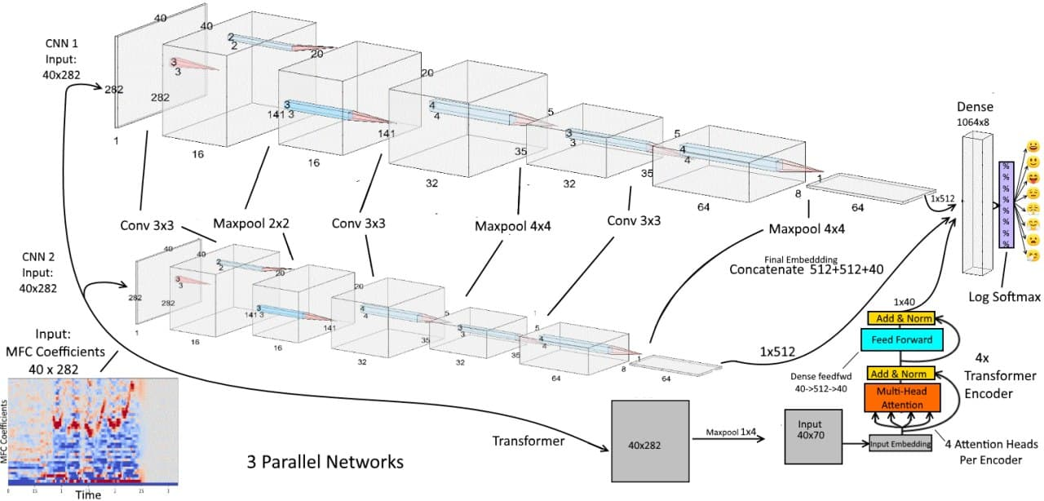
This is the first original model consisting of 2 parallel CNN with a transformer layer that achieved an accuracy of 75% on RAVDESS dataset.we did add a new layer in 2 parallel CNN
which achieved 75.12% and we make 3 CNN parallel with the transformer layer
we modified augmentation on train dev by white Gaussian noise raise accuracy to 79% and modified at last modification model by stop early raise accuracy 80.86% on RAVDESS dataset

Slide 19
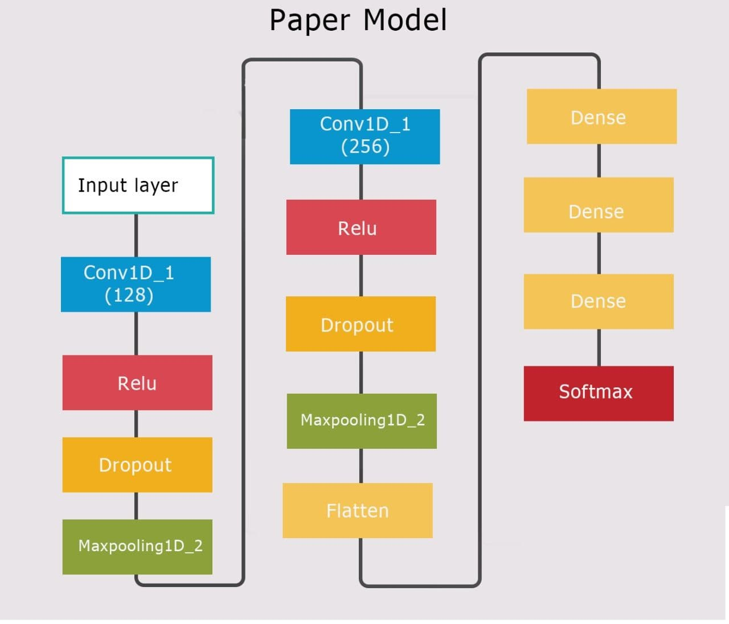
The second model consists of 2 Conv layers, used activation function Relu and dropout regularization and falten layer, 3 dense layers and softmax.[1]
Achieved 70.83% accuracy on ravdess dataset and 61.46% on savee dataset.

Slide 24
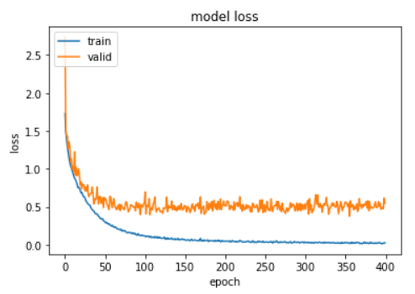
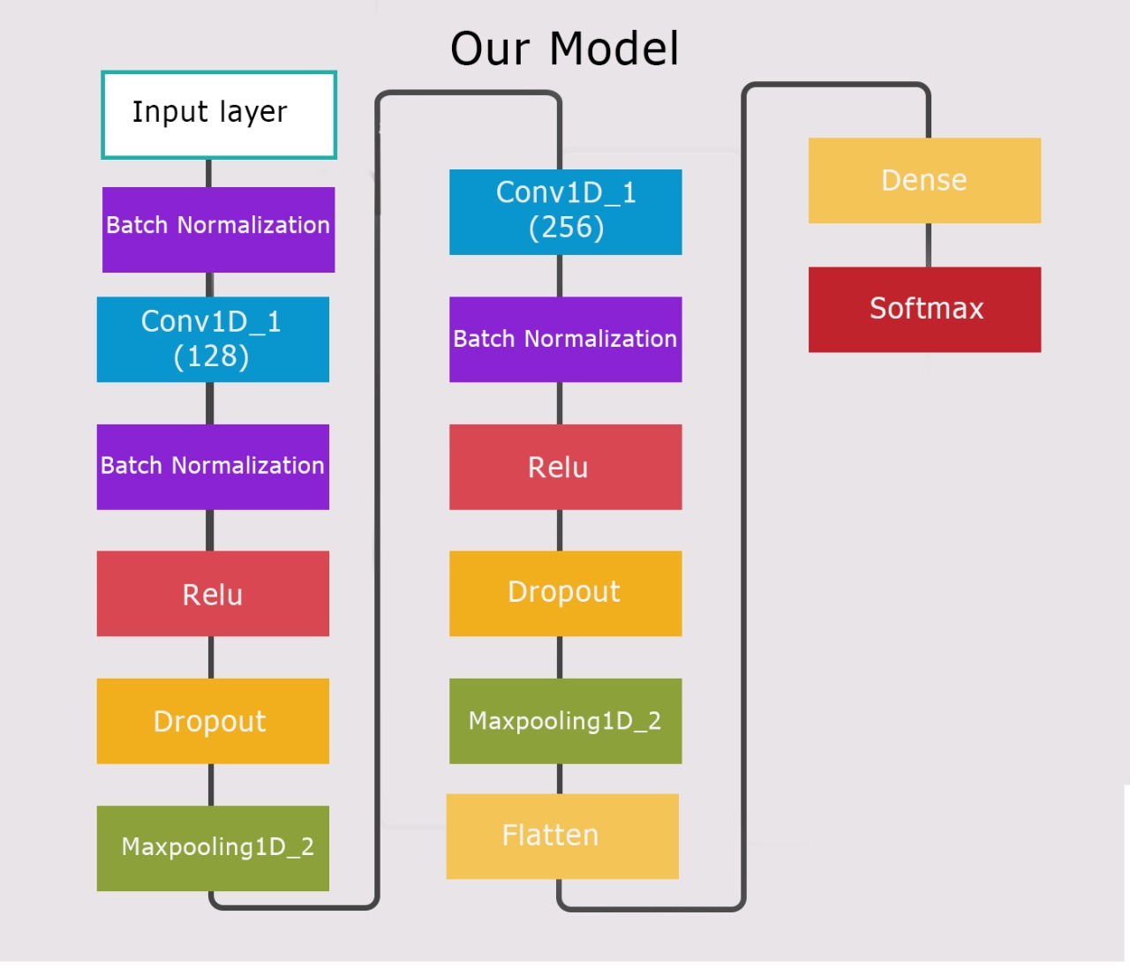
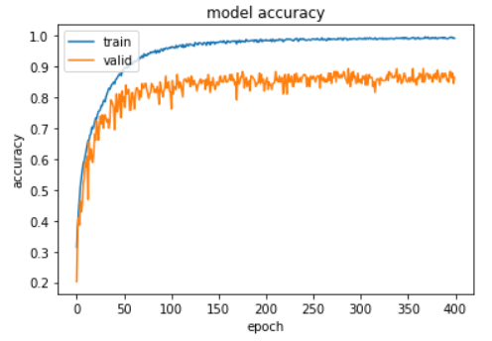
we did augmentation on training set only with time_stretch and pitch_shift.
modified model by adding 3 batch normalization layers,the first one after input layer, the second one after the first Conv layer and the last one after the second conv layer, changing dropout rate 0.1 in the first conv layer and 0.3 in the second conv layer, change kernel size to 12 and remove 2 dense layer from original model.
Achieved 86.47% on RAVDESS dataset and 75.00% on SAVEE dataset.

Slide 25
Hyper parameter | Original model | Our model
optimizer | ----- | adam
# epocs | ---- | 400
Learning rate | 0.00002 | 0.0002
Drop out rate | 0.3 | 0.1 in first Conv layer
 |  | 0.3 in second Conv layer

Slide 27
Phases
FUSION PHASE
START:25/4/2022
END:14/5/2022
DURATION: 20 DAYS
VIDEO PHASE
START:7/3/2022
END:23/4/2022
DURATION: 48 DAYS
AUDIO PHASE
FINISHED
Training and Testing different Models with different techniques
try to modify Models with highest accuracy.
Collecting and comparing results
try to find best method for fusion.
Collecting and comparing results
Run Different audio model based on MFCC and mel spectogram.
try to modify Audio Models with highest accuracy.
Collecting and comparing results

Slide 28
REFERENCES
[1] Kataria, Gaurav, et al. "Emotion Recognition from Speech Signals Using Machine Learning and Deep Learning Techniques." Concepts and Real-Time Applications of Deep Learning. Springer, Cham, 2021. 63-73.
https://doi.org/10.1007/978-3-030-76167-7_4#DOI
[2] S. O. S. R. D. S. a. D. M. Sarala Padi, "Improved Speech Emotion Recognition using Transfer Learning and Spectrogram Augmentation," International Conference on Multimodal Interaction (ICMI ’21),, p. 8, 2021.
[3] B. Puterka and J. Kacur, "Time Window Analysis for Automatic Speech Emotion Recognition," IEEE, p. 4, 16- 19 9 2018.
[4] X. X. C. a. C. C. Wang, "Human emotion recognition by optimally fusing facial expression and speech feature," 2020.
[5] &. S. R. Arnold Sachith A Hans, "A CNN-LSTM BASED DEEP NEURAL NETWORKS FOR FACIAL EMOTION DETECTION IN VIDEOS," INTERNATIONAL JOURNAL OF ADVANCES IN SIGNAL AND IMAGE SCIENCES, pp. 11- 20, 2021
[6] Z. e. a. He, "Human emotion recognition in video using subtraction pre-processing," International Conference on Machine Learning and Computing, November 2019.

Slide 29
[7] Y. H. M. C. J. C. P. L. A. K. Yaxiong Ma, "Audio-visual emotion fusion (AVEF): A deep efficient weighted approach,".
[8] S. Zhang, S. Zhang, T. Huang, W. Gao and Q. Tian, "Learning Affective Features with a Hybrid Deep Model for Audio-Visual Emotion Recognition," Transactions on Circuits and Systems for Video Technology, 2017.
[9] ,. D. G. 2. ,. Z. C. 2. ,. R. K. 1. ,. J. M. M. 1. a. F. F.-M. Cristina Luna-Jiménez 1, "Multimodal Emotion Recognition on RAVDESS Dataset Using Transfer Learning," 18 November 2021.
[10] G. Mendels, "Towards Data Science," 18 Nov 2019. [Online]. Available: https://towardsdatascience.com/how-to-apply-machine-learning-and-deep-learning-methods-to-audioanalysis-615e286fcbbc.
[11] A. H. L. Lu, L. . M. T. Ö. and . E. B. , "Audio Representation," MA: Springer US, p. 8, 2009.
.

Slide 30
Thank you

